Slide 1
Automating Clinical Trial Data Analysis with R
使用 R 自动化临床试验数据分析
刘翔
Liu Xiang

Slide 2
本幻灯内容仅代表个人观点，仅供参考。
The content of this presentation represents personal opinions only and is provided for reference purposes.

Slide 3
系统开发背景 System Development Background
临床试验中生成的数据日益复杂且数量庞大，这要求采用高效、可重复且准确的数据分析方法。最好的方法就是开发一款自动化临床试验数据分析系统。本幻灯将介绍一款基于R的自动化临床试验数据分析系统，目前该系统尚处于开发当中。在这里与大家分享我的一些经验和想法。
系统采用R有以下几点原因：R是一种功能强大的开源编程语言，适用于统计计算和图形绘制，有丰富的扩展包，有活跃的社区支持，广泛应用于学术界和工业界。
开发一个数据分析系统，首先得搞清楚数据分析的流程。
System Development Background：The data generated in clinical trials is becoming increasingly complex and voluminous, necessitating efficient, reproducible, and accurate data analysis methods. The best approach is to develop an automated clinical trial data analysis system. This presentation introduces an R-based automated clinical trial data analysis system currently under development. Here I share some of my experiences and thoughts.
The system uses R for several reasons: R is a powerful open-source programming language suitable for statistical computing and graphical visualization, with a rich ecosystem of packages, active community support, and widespread use in both academia and industry.
To develop a data analysis system, it is essential to first understand the data analysis workflow.

Slide 4
数据分析流程 Data Analysis Workflow
Raw Data
SDTM Data
ADaM Data
Table Figure Listing
试验采集的数据一般需要经过处理后才适合用于统计分析，在行业中，一般的分析流程如下：
Data collected from trials typically requires processing before it is suitable for statistical analysis. In the industry, the general analysis workflow is as follows：
rdata
csv
xlsx
xml
sas7bdat
…
dm.rdata
ds.rdata
ex.rdata
ae.rdata
lb.rdata
…
adsl.rdata
adae.rdata
adlb.rdata
…
pdf
rtf
...

Slide 5
系统开发框架 System Development Framework
数据分析流程决定了系统开发框架，将各步骤分别开发为相应的功能模块，最后在系统框架下整合所有模块。当然，作为一个系统，除了由分析流程决定的主要模块，还需要其他一些辅助模块，例如项目管理等。
The data analysis workflow determines the system development framework. Each step is developed into a corresponding functional module, and all modules are integrated under the system framework. Of course, as a system, in addition to the main modules determined by the analysis workflow, other auxiliary modules are needed, such as project management.

Slide 6
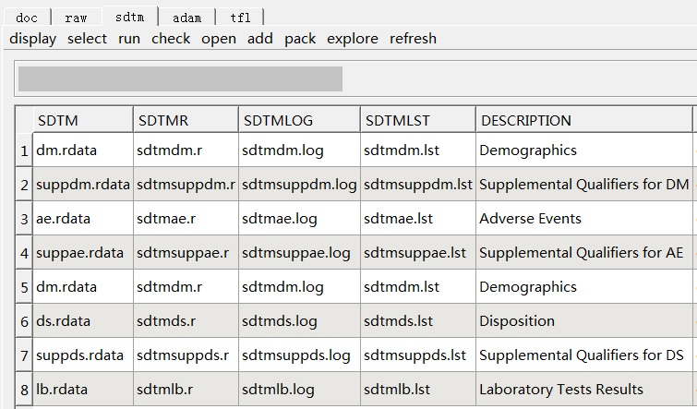
系统功能模块-SDTM System Functional Module - SDTM
根据数据分析流程，我正在开发部分功能模块，SDTM模块系统界面如下：
According to the data analysis process, I am developing some functional modules. The system interface for the SDTM module is as follows:

Slide 7
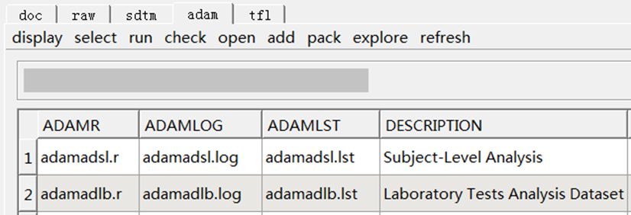
系统功能模块-ADaM System Functional Module - ADaM
ADaM模块系统界面如下：
The system interface for the SDTM module is as follows:

Slide 8
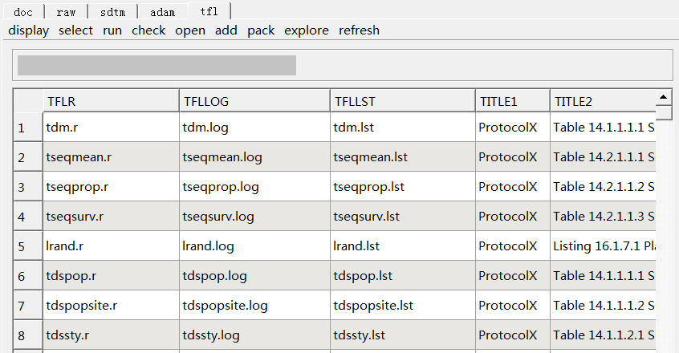
系统功能模块-TFL System Functional Module - TFL
TFL模块系统界面如下：
The system interface for the TFL module is as follows:

Slide 9
利用系统生成统计表格的过程 Process of Generating Statistical Tables Using the System
因系统尚处于开发中，本幻灯仅介绍统计图表生成过程，其他功能，例如分析数据的生成，将来待完成开发后介绍。
开发自动化系统完成一张统计表格的生成，需要具备以下要素：
分析数据集
表格模板
表格R程序
可视化操作界面
以上要素均为系统的组成部分，系统在执行生成表格命令时，例如点击可视化操作界面中的表格运行按钮，将先对分析数据集、表格模板、表格R函数进行完整性和有效性校验，完成校验后开始运行表格R程序，完成运行后给出程序运行成功或失败的提示信息，并同步生成程序运行记录，提供运行失败原因，方便对程序进行纠错。
接下来以生成一张人口学和基线特征的表格为例进行演示，该例子所呈现图片来自于我的个人微信公众号 – 翔哥学SAS。假设已经提前准备好了用于该表格的分析数据集ADSL。
Since the system is still under development, this presentation only introduces the process of generating statistical tables. Other functionalities, such as generating analysis data, will be introduced after development is completed.
To develop an automated system for generating a statistical table, the following elements are required:
Analysis dataset
Table template
Table R program
Visual operation interface
These elements are all components of the system. When the system executes the command to generate a table, such as clicking the table run button on the visual operation interface, it first validates the integrity and effectiveness of the analysis dataset, table template, and table R function. After validation, the table R program runs, and upon completion, a prompt indicating success or failure is provided. A program run log is also generated, offering reasons for any failures to facilitate debugging.
Next, we demonstrate the generation of a demographic and baseline characteristics table. The images in this example are from my personal WeChat public account - 翔哥学SAS. Assume that the analysis dataset ADSL for this table has been prepared in advance.

Slide 10
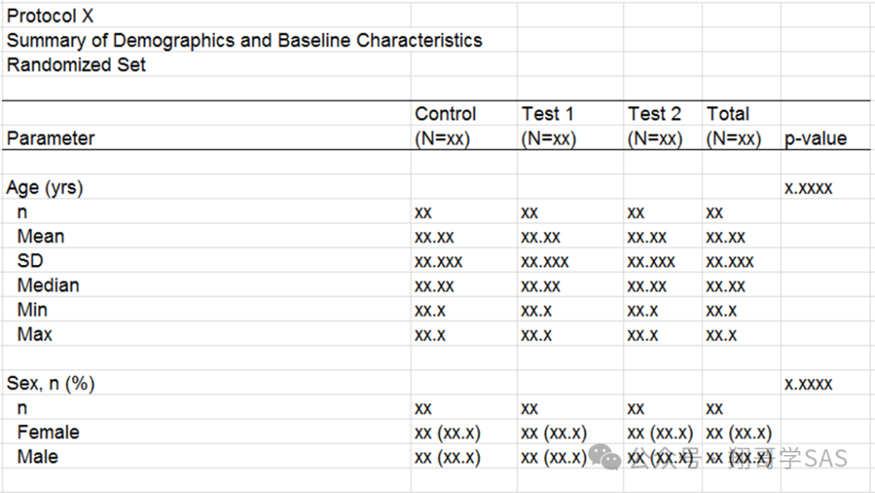
表格模板 Table Template
以下是一个简化的人口学和基线特征汇总表模板：
Below is a simplified template for summarizing demographic and baseline characteristics:

Slide 11
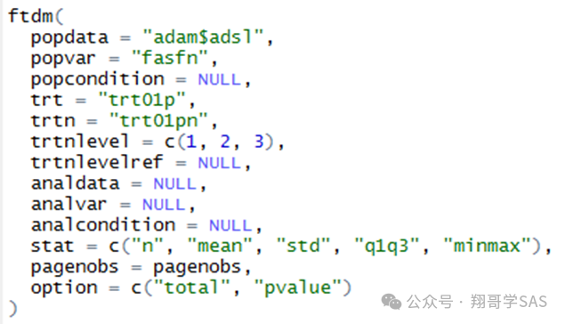
表格R程序 Table R Program
生成人口学和基线特征汇总表的R程序，我整合成了一个R函数，通过设置若干参数，可以实现代码的重用：
The R program for generating the summary table of demographic and baseline characteristics is integrated into an R function. By setting several parameters, code reuse can be achieved:

Slide 12
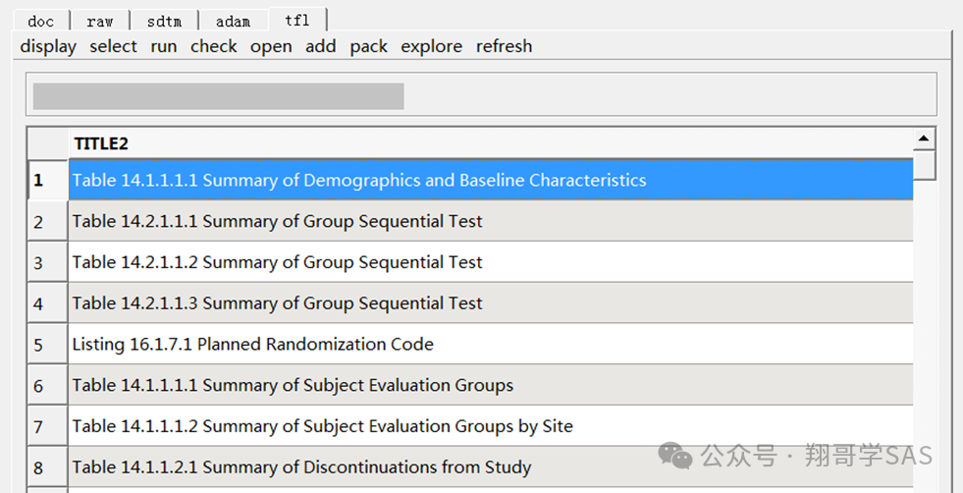
可视化操作界面 Visual Operation Interface
作为一个自动化系统，可视化操作界面是需要的，具体界面设计可以按需定制，以下是我开发的一个：
As an automated system, a visual operation interface is necessary. The specific interface design can be customized as needed. Below is one that I developed:

Slide 13
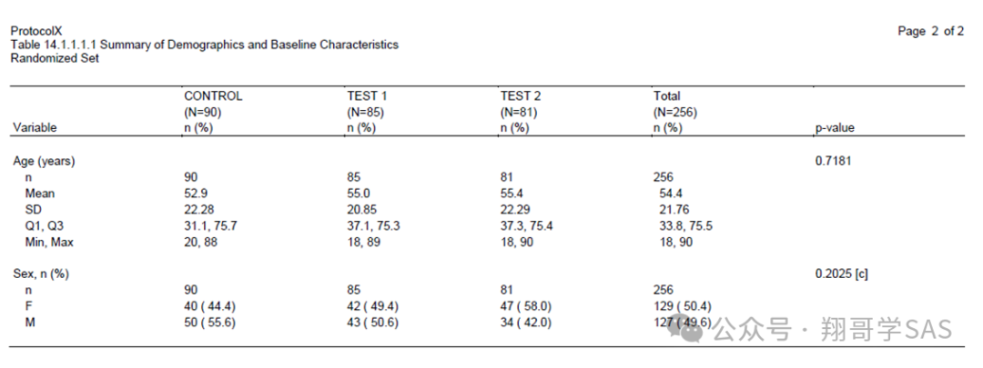
表格生成 Table Generation
程序成功运行后将生成的表格以PDF格式的文件呈现，也可以生成RTF格式或者两者都生成：
After the program runs successfully, the generated table will be presented in PDF format, or RTF format, or both:

Slide 14
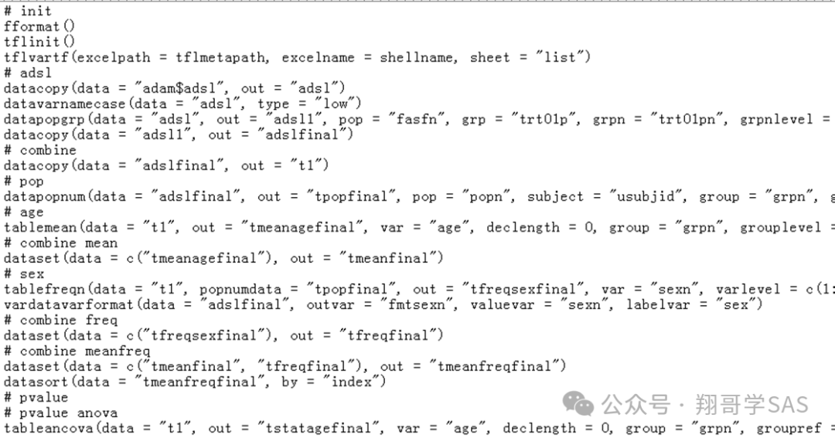
解析后程序文件 Parsed Program File
程序成功运行后还会生成一个文本文件，其中包含解析后的R代码，详细记录每一步分析过程：
After the program runs successfully, a text file containing the parsed R code is also generated, detailing each step of the analysis process:

Slide 15
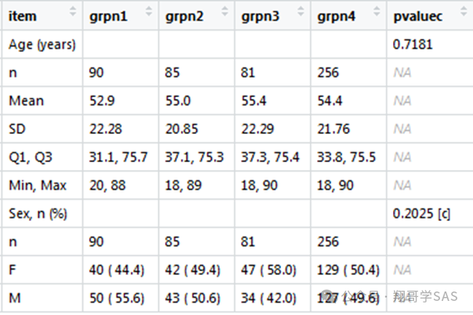
生成表格前的数据集 Dataset Before Table Generation
行业内一般是先生成匹配表格模板的数据集，然后再生成对应的表格文件，以下是例子中用于生成人口学和基线特征汇总表的数据集：
According to industry practices, a dataset matching the table template is usually generated first, followed by the corresponding table file. Below is the dataset used in the example to generate the summary table of demographic and baseline characteristics:

Slide 16
系统架构和拓展 System Architecture and Expansion
系统可以开发成B/S架构或者C/S架构，现在比较流行的是C/S架构。
在系统拓展这一块，以后可以对接EDC系统、CSR系统等，逐步实现临床研究的整体自动化。
The system can be developed as a B/S (Browser/Server) or C/S (Client/Server) architecture, with the latter being more popular nowadays. For system expansion, it can later integrate with EDC (Electronic Data Capture) systems, CSR (Clinical Study Report) systems, etc., gradually achieving overall automation in clinical research.

Slide 17
谢谢
Thanks
有任何问题，欢迎联系15821804030 liuxiang_yx@163.com
Any questions, please feel free to contact 15821804030 liuxiang_yx@163.com

